Slide 1

Vehicle detection system
Ng Chung Wah (Leader)
Chan Chak Fung
Chung Tin Ho
Kuok Chun Cho

Slide 2
Background
Why Vehicle Detection?
Improve Traffic Management
Reduce environmental impact
Strengthen economic growth
Enhance infrastructure Development
Notes:
Practical Traffic Managementby adjusting traffic signals based on actual road usage and optimize flow through high-traffic areas, reducing wait times.
Environmental & Economic Impact: we can lower the time vehicles spend idling at intersections or in traffic jams. This leads to less fuel consumption and a reduction in greenhouse gas emissions, contributing to cleaner air quality and environmental sustainability.
Infrastructure Development: “Accurate vehicle detection helps city planners to make informed decisions about new roads, highways, and public transport options. This helps ensure that infrastructure is developed in a way that meets the real needs of the population and supports efficient transportation.

Slide 3
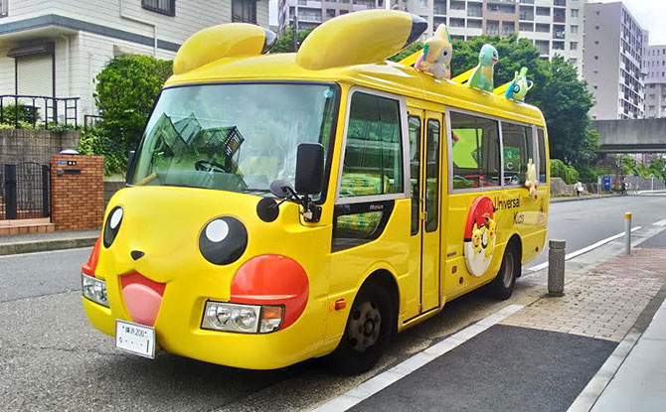
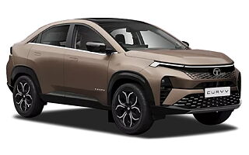
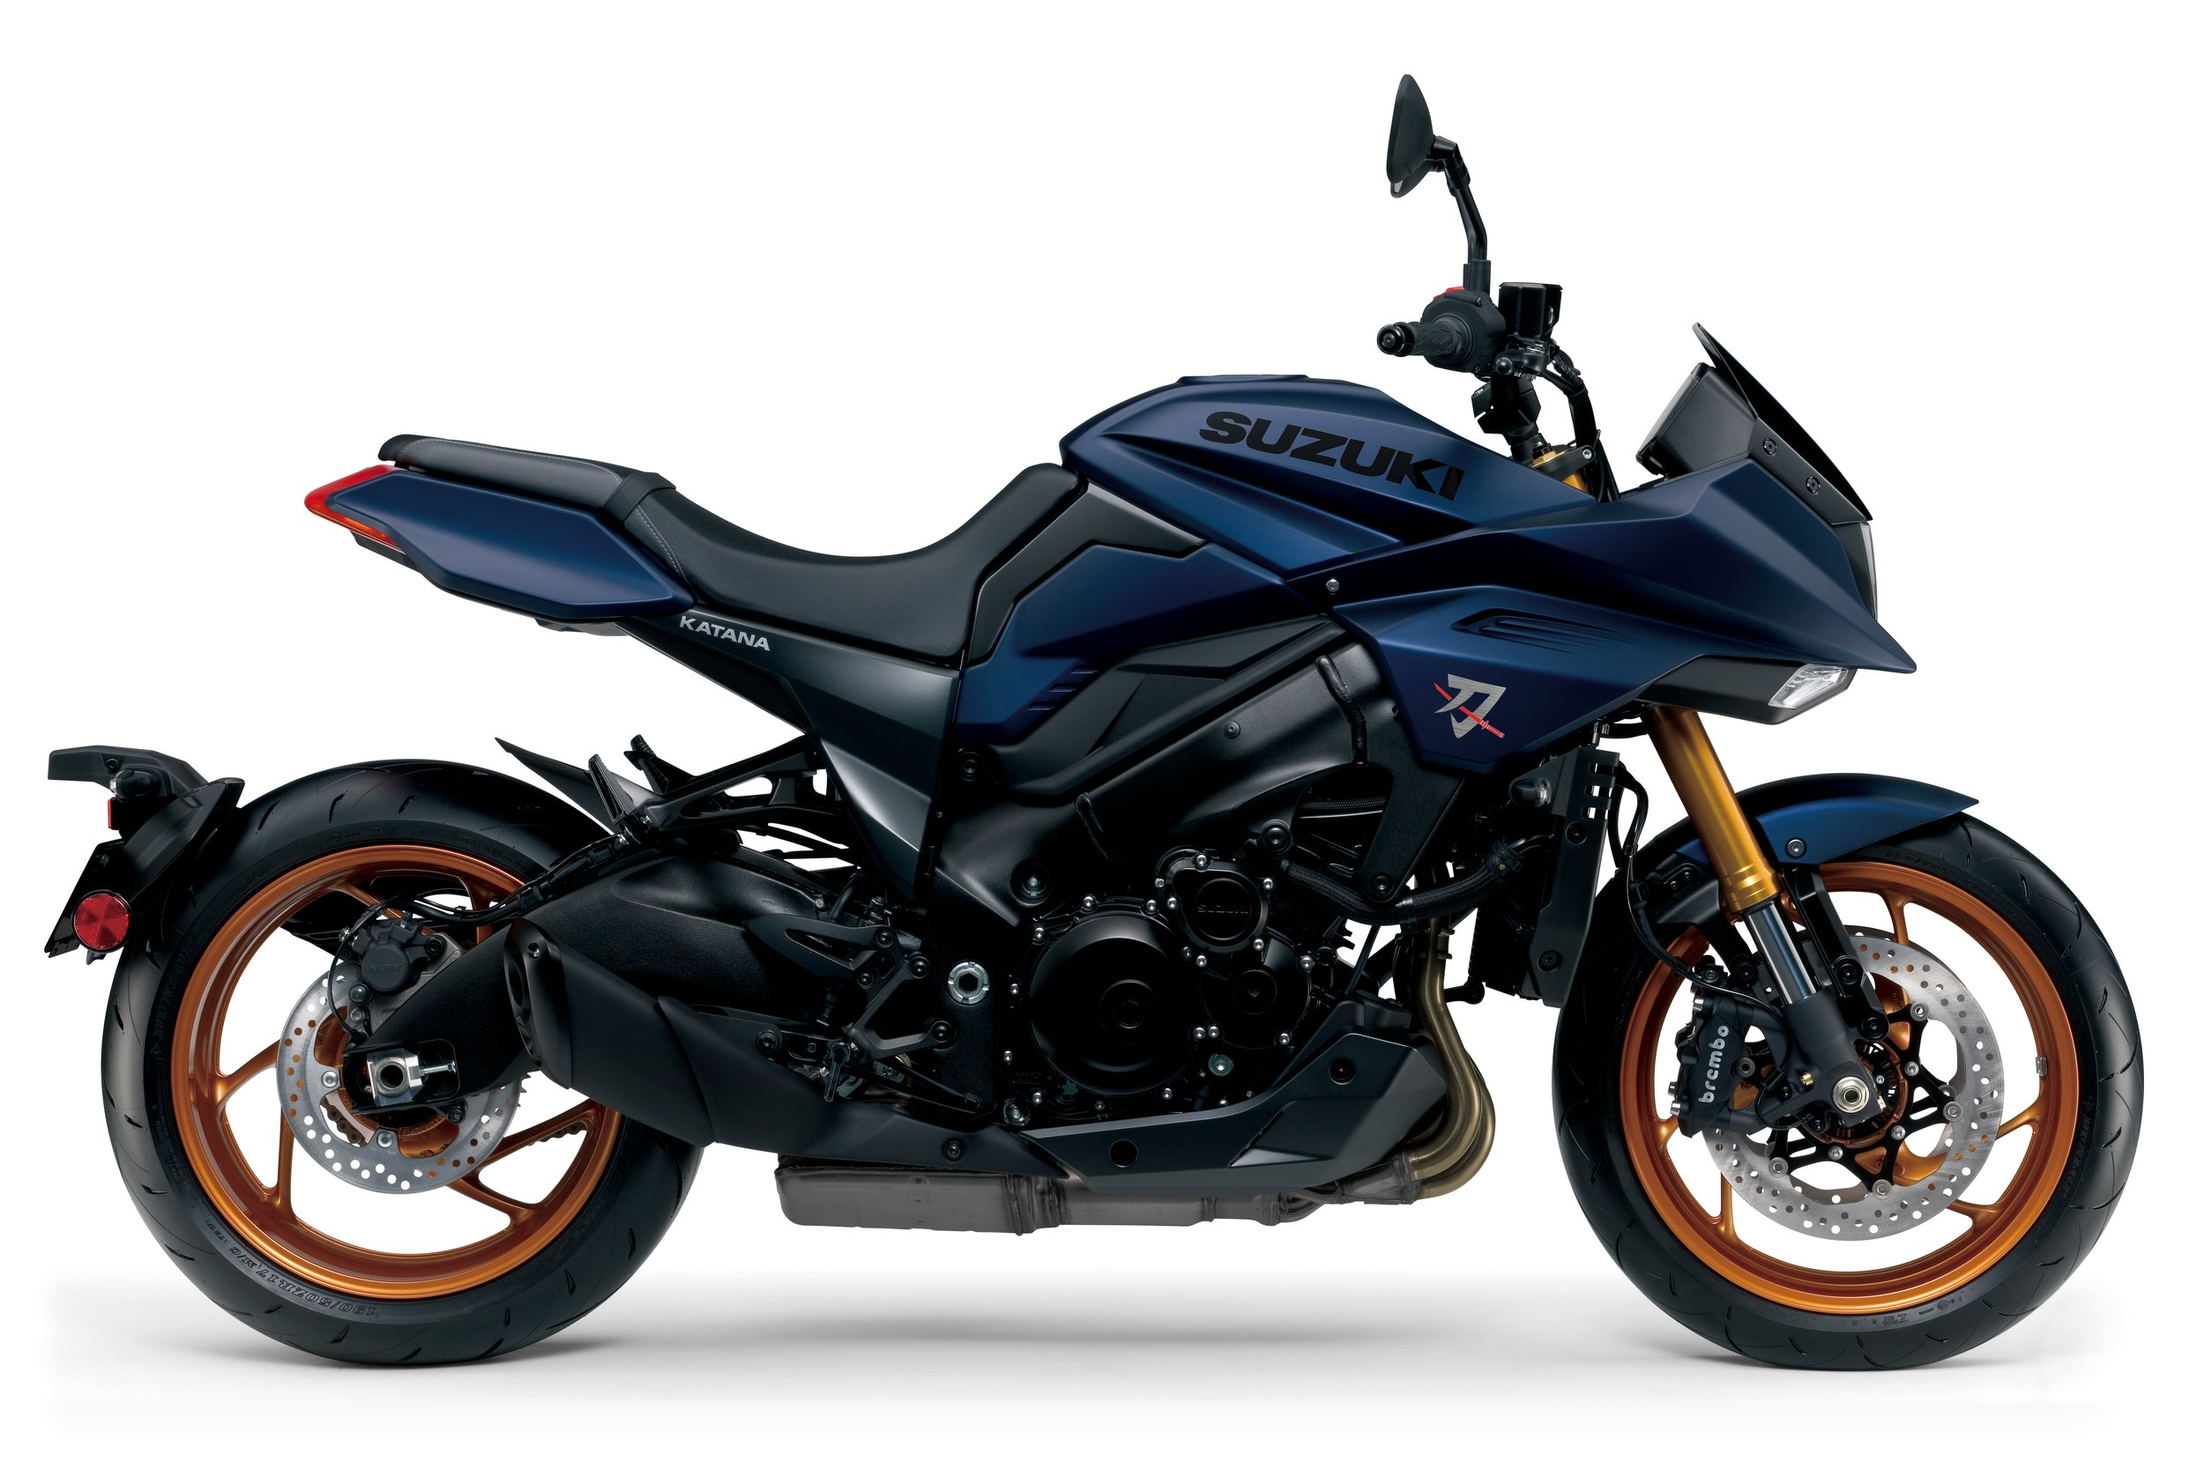
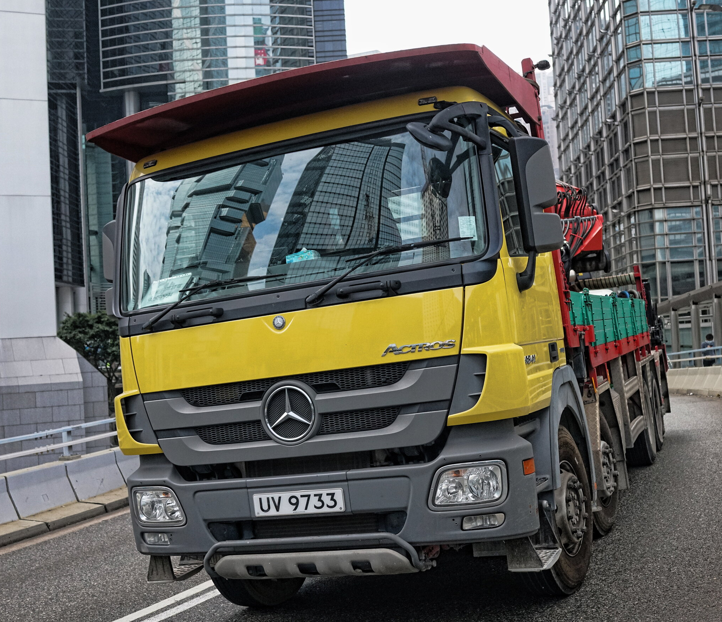
Background (Cont.)
Design
Uses Deep learning (CNN)
Tried using Non-Deep learning (SVM)
Detects 4 types of vehicles (Cars, Buses, Trucks, Motorcycles)

Slide 4
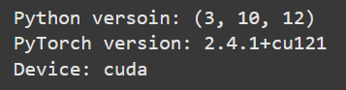
How we run the code
On local GPU
Online is too slow, sometimes disconnects

Slide 5
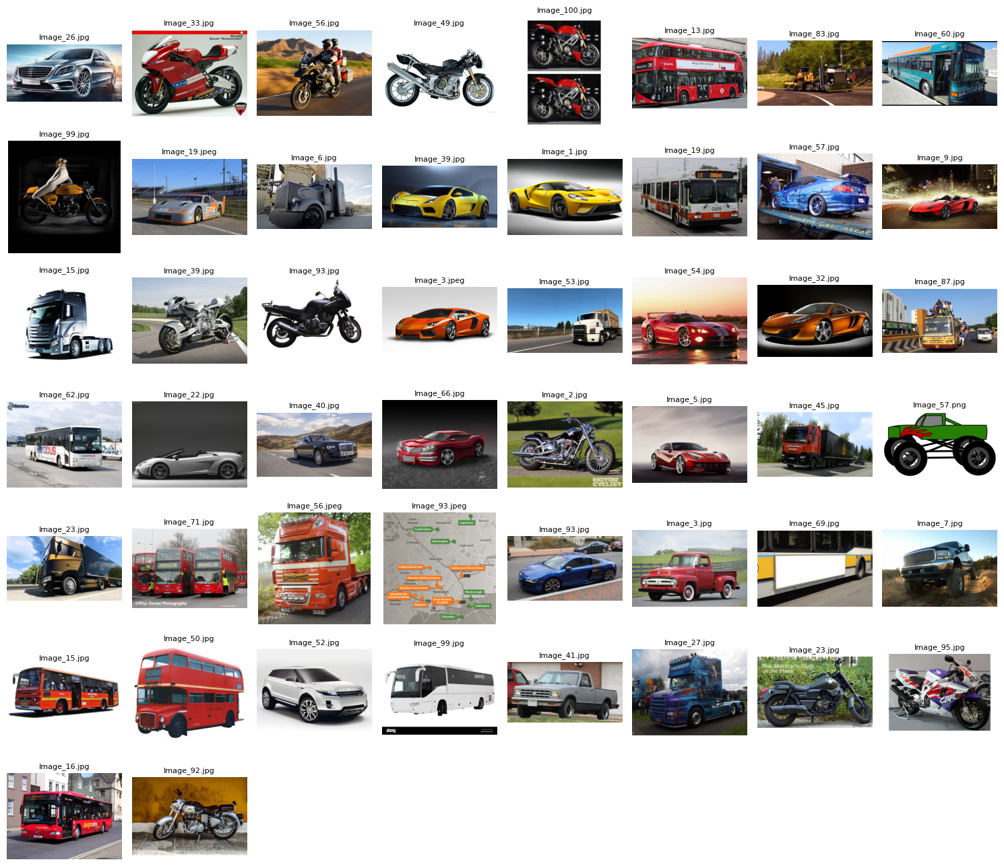
Dataset
169.72 MB
400 photos
100 Buses
100 Cars
100 Motorcycles
100 Trucks
https://www.kaggle.com/datasets/kaggleashwin/vehicle-type-recognition

Slide 6
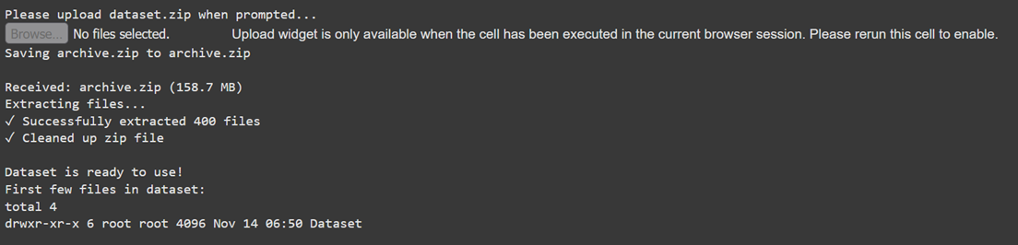
Implementing the dataset to the code
Upload and unzip from local

Slide 7
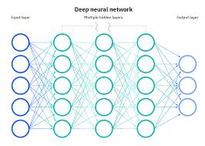
Deep learning vs Non-Deep learning
Deep Learning:
-Uses Neural Networks with multiple layers (deep architectures).
-Automatically learns features from raw data (e.g., images, text).
-Requires large datasets to perform well.
-Typically computationally intensive, requiring GPUs/TPUs for training.
For example: Convolutional Neural Networks (CNNs), Recurrent Neural, Networks (RNNs), Transformers, etc.

Slide 8
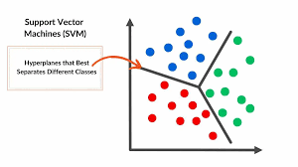
Deep learning vs Non-Deep learning (cont.)
Non-deep Learning (Traditional Machine Learning):
-Does not use neural networks (or uses shallow networks).
-Manual feature engineering often required.
-Can work well with small to medium-sized datasets.
-Less computationally demanding compared to deep learning.
For example: Support Vector Machines (SVM), Decision Trees, Random Forest, K-Nearest Neighbors (KNN).

Slide 9
First Attempt with non-deep learning: SVM
Introduction
-Support vector machine (SVM) algorithm was invented in 1964.
-SVM is a traditional machine learning algorithm that uses supervised learning models to solve complex classification, regression, and outlier detection problems by performing optimal data transformations that determine boundaries between data points based on predefined classes, labels, or outputs.
-SVMs are widely adopted across disciplines such as healthcare, natural language processing, signal processing applications, and speech & image recognition fields.

Slide 10
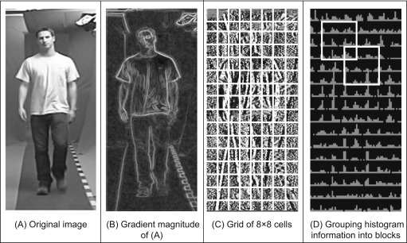
SVM: Methodology
1.Linear Model: The SVM is implemented as a linear model with a single fully connected layer.
2.Hinge Loss: The hinge loss function is used to maximize the margin between classes. the goal is to penalize misclassified points that fall within the margin or on the wrong side of the decision boundary.
3.Regularization: L1 regularization is applied to prevent overfitting and encourage sparse weights, which helps improve generalization.
4.SGD Optimization: SGD is used for optimizing the model parameters, with a learning rate schedule for fine-tuning. The learning rate is further scheduled using StepLR, which decreases the learning rate by a factor of gamma every step_size epochs.

Slide 11
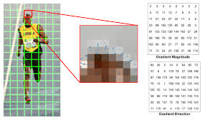
SVM: Methodology(cont.)
5.HOG Features: HOG features are extracted from input images to serve as input to the SVM.
The dataset is preprocessed using Histogram of Oriented Gradients (HOG), a feature descriptor that is widely used for object detection and image classification tasks.
The torch_hog.HOG module is used to extract the HOG features from the input images. These features serve as the input to the SVM model.
This process converts the images into a feature vector of size 3780 (as set in the args.input_size), which is then classified by the SVM.

Slide 12
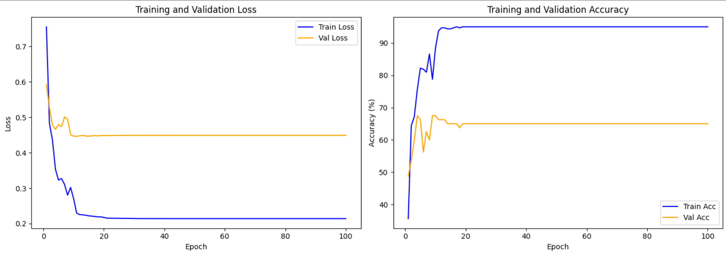
SVM:Results
Visualization Best validation accuracy: 67.50%

Slide 13

SVM:result(cont.)
1. Training and Validation Loss (Left Plot)
Train Loss (Blue Line): Steadily decreases, approaching near-zero after 20 epochs, indicating that the model is learning the training data well.
Val Loss (Orange Line): Decreases initially but flattens around 0.5 after 10 epochs, suggesting overfitting as the model fails to improve on unseen validation data.
2. Training and Validation Accuracy (Right Plot)​
Train Accuracy (Blue Line): Increases rapidly, reaching near 100% after 20 epochs, showing the model is fitting the training data almost perfectly.​
Val Accuracy (Orange Line): Rises quickly but plateaus around 67-68% after 10 epochs, confirming overfitting, as validation performance stops improving.
ThePhoto by PhotoAuthor is licensed under CCYYSA.

Slide 14
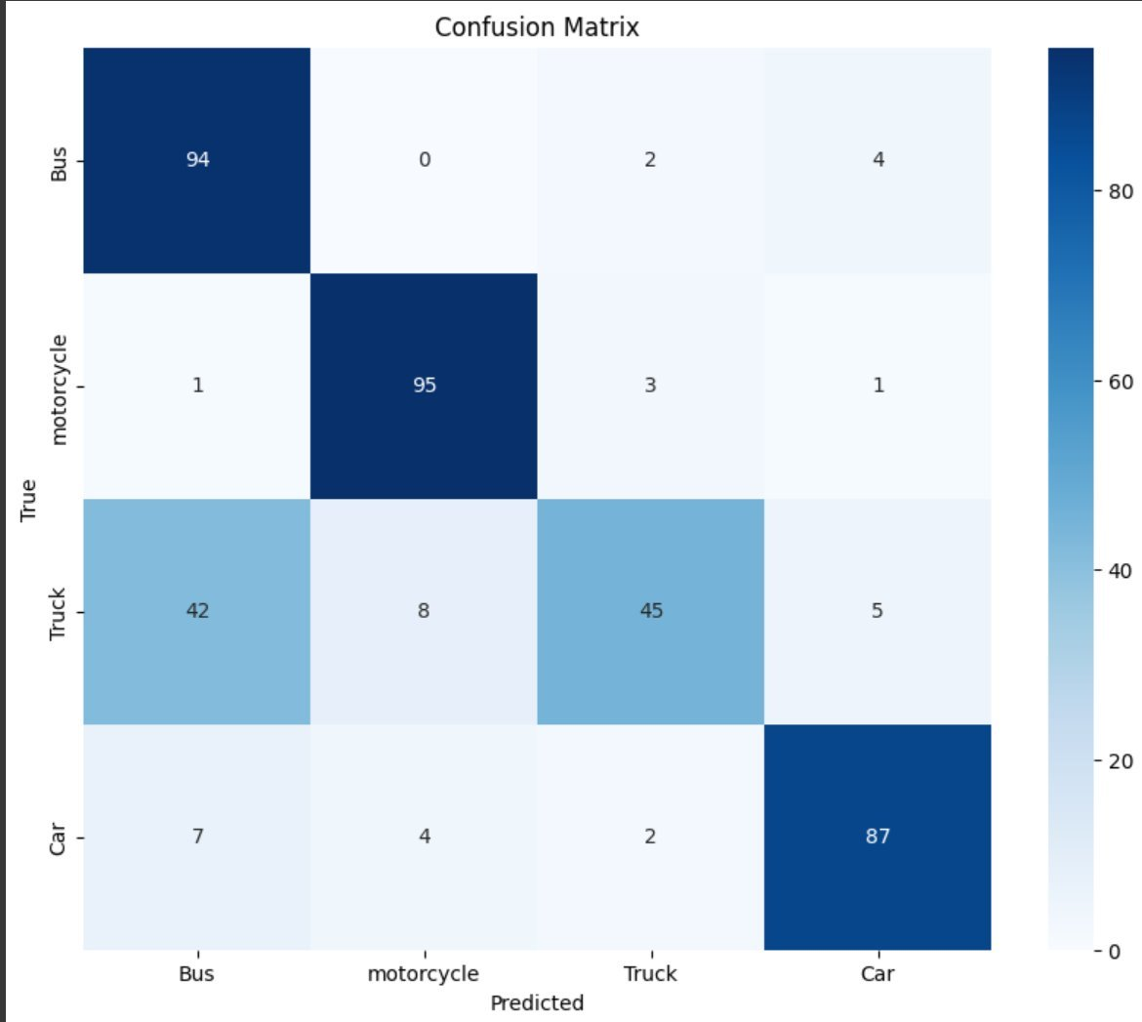
SVM: Confusion matrix
The confusion matrix shows the number of correct and incorrect predictions made by the model for each class.
-Bus and Motorcycle classes are classified fairly well, with high correct predictions and few misclassifications.
- The Truck class has the most misclassifications. Many trucks are being misclassified as buses (42 instances), indicating that the model struggles to distinguish between these two classes.
- Car class also performs well, although a few cars are misclassified as buses and motorcycles.

Slide 15
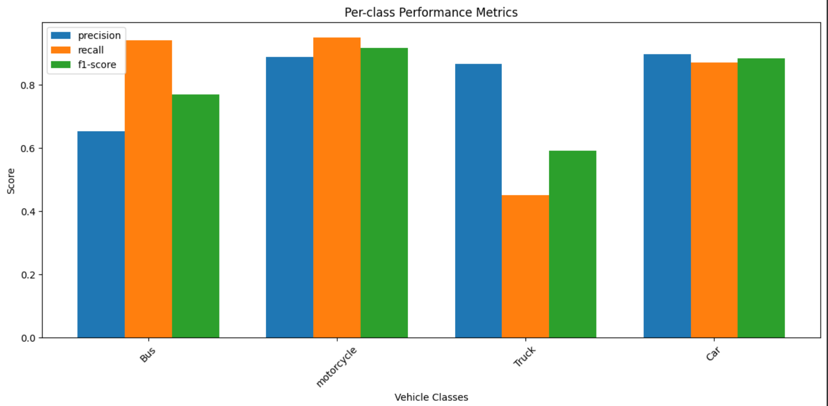
SVM:Per-class Precision, Recall, and F1-Score
The model performs best on motorcycles, with high precision, recall, and F1-score.
- The Truck class is the weakest, with very poor recall. This confirms what we saw in the confusion matrix: the model frequently misclassifies trucks as buses.
- Bus and Car classes perform reasonably well but still have room for improvement in precision

Slide 16
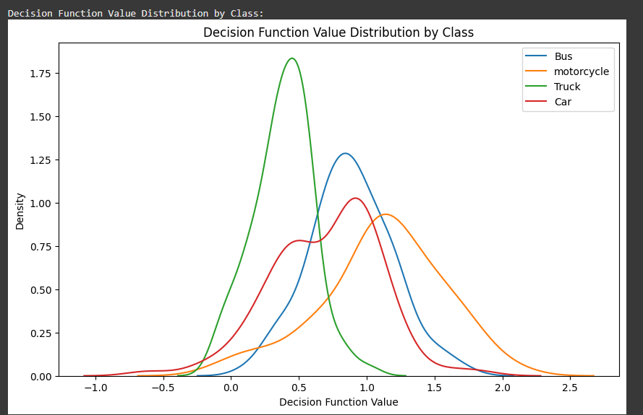
SVM:Decision Function Value Distribution by Class
- The motorcycle class has the highest confidence, while the truck class has the lowest confidence. This supports the previous findings that the model is very good at classifying motorcycles but struggles with trucks.
- The bus and car classes show moderate confidence, but there is some spread, indicating uncertainty in some predictions

Slide 17
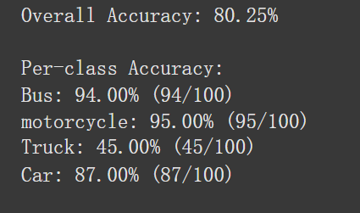
SVM:Overall accuracy
Overall Accuracy: 80.25% from pervious information, this means that out of all the images in the dataset, the model correctly classified about 80% of them.
While this is a decent accuracy, there is still room for improvement, especially in the truck class, which is pulling down the overall performance.

Slide 18
SVM:Per-class accuracy
The truck class is the major issue here, with only 45% accuracy. This is the class the model struggles with the most, likely due to visual similarities with buses.
- The model performs best on motorcycles and buses, with both having accuracies above 90%
- Cars are also classified well, but there is still some room for improvement

Slide 19
What can we do to improve?
Transfer learning
SVM albeit 80%, accuracy is unevenly distributed
Significantly low accuracy with trucks
Ditch SVM, embrace CNN

Slide 20
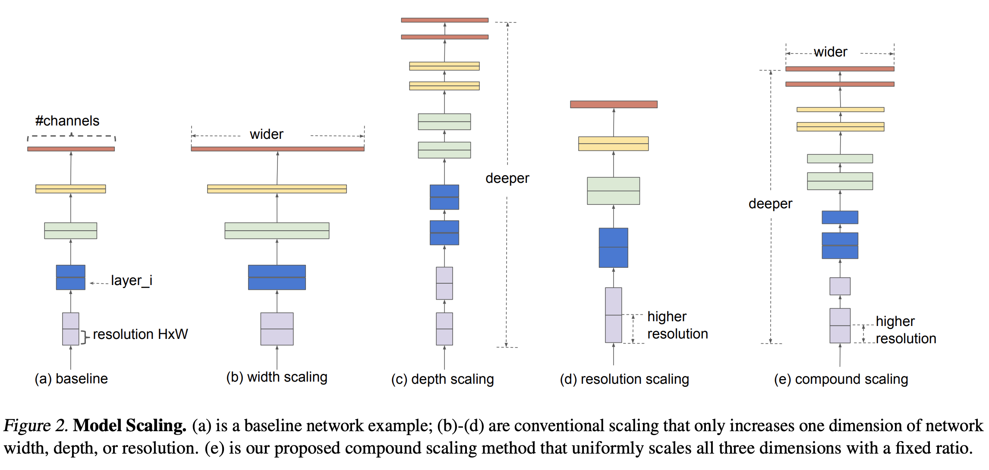
EfficientNet
Based on a convolutional neural network (CNN) architecture
Uniformly scales all dimensions (depth, width, resolution)
Used to achieve balanced scaling across all dimensions.
Notes:
EfficientNet is a convolutional neural network architecture and scaling method that uniformly scales all dimensions of depth/width/resolution using a compound coefficient.

Slide 21
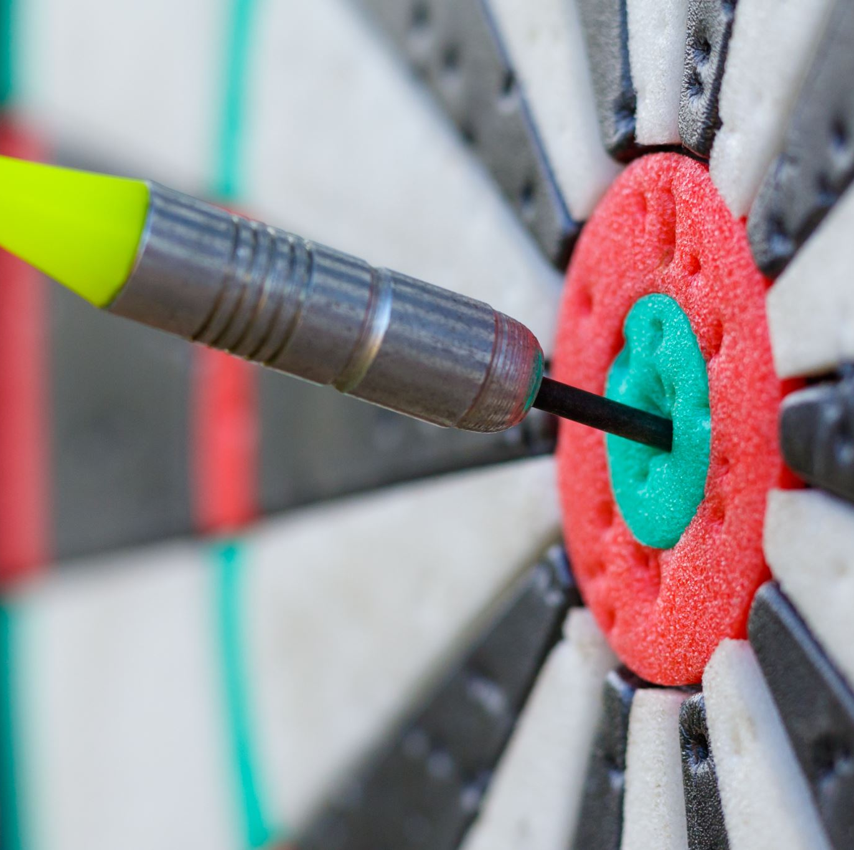
EfficientNet
EfficientNet-B0: Fast inference, small size
EfficientNet-B1: Better accuracy with minimal cost.
EfficientNet-B2: Balanced version
EfficientNet-B3: Offers better accuracy than B2
EfficientNet-B4: Strong accuracy, ideal for most tasks.
EfficientNet-B5: Higher accuracy than B4
EfficientNet-B6: Near-max accuracy
EfficientNet-B7: State of the Art level

Slide 22
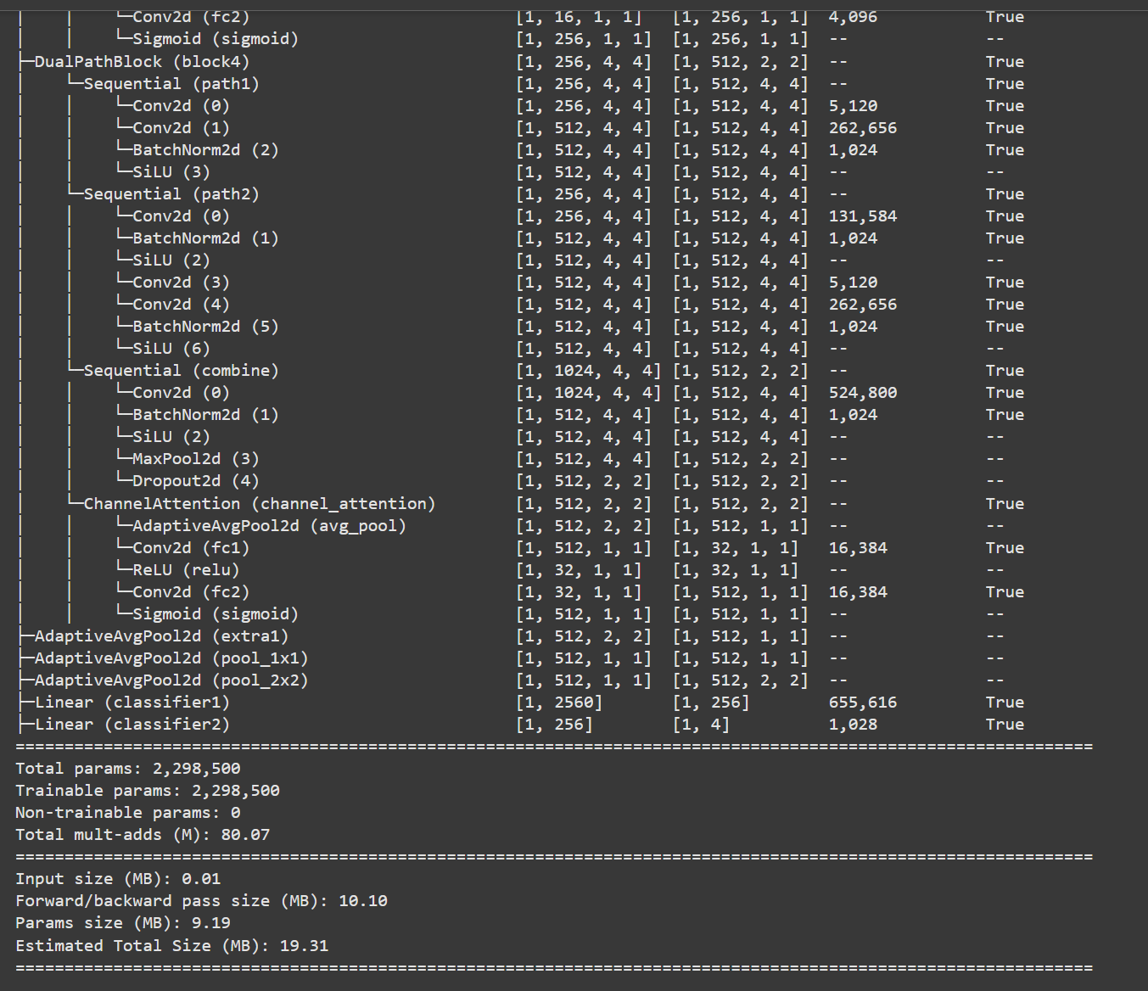

Slide 23
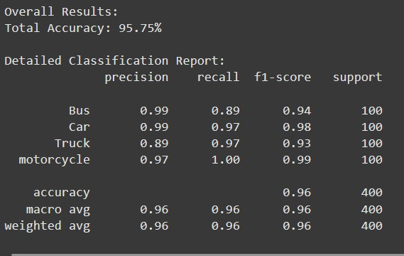
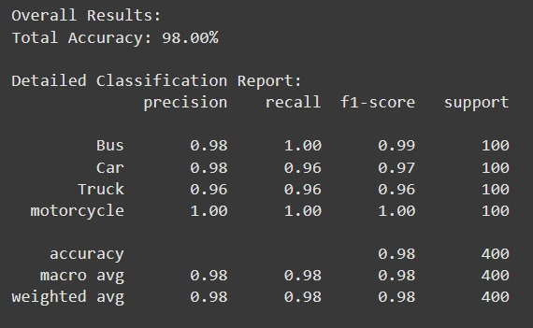
Version Comparison
B4
B7
B0
Overfit
Too fast

Slide 24
Other Techniques Used
Data Augmentation:
RandomHorizontalFlip
RandomVerticalFlip
RandomResizedCrop
Resize
CenterCrop
ColorJitter
RandomAffine
Normalize
RandAugment
RandomErasing
Optimizer:
AdamW
Scheduler:
CosineAnnealingWarmRestarts
Model Used:
EfficientNet-B4
Notes:
RandomHorizontalFlip: Flips the image horizontally with a probability of 0.5 by default. Useful for making the model invariant to horizontal orientation.
RandomVerticalFlip (p=0.2): Flips the image vertically with a probability of 0.2, which can be useful for certain image types but should be used with caution in contexts where vertical orientation is significant.
RandomResizedCrop (224, scale=(0.8, 1.0)): Crops a random portion of the image and resizes it to 224x224 pixels. The scale parameter ensures that the area of the crop is between 80% and 100% of the original image size, allowing for variability in the focus of the crop.
Resize (256): Resizes the image to 256 pixels on the shorter side while maintaining the aspect ratio. This is often a preparatory step before cropping.
CenterCrop (224): Crops the center portion of the image to 224x224 pixels. Ensures consistent input size and focuses on the central part of the image.
ColorJitter (brightness=0.3, contrast=0.3, saturation=0.3, hue=0.1): Randomly changes the brightness, contrast, saturation, and hue of the image to make the model resilient to varying lighting conditions and color distortions.
RandomAffine (degrees=10, translate=(0.1, 0.1), scale=(0.9, 1.1)): Applies affine transformations like rotation (up to ±10 degrees), translation (up to 10% of the width and height), and scaling (between 90% and 110%). This helps simulate slight geometric variations.
Normalize (mean=[0.485, 0.456, 0.406], std=[0.229, 0.224, 0.225]): Normalizes the image using the mean and standard deviation of the ImageNet dataset, which is common when working with pretrained models.
RandAugment (num_ops=2, magnitude=9): Applies a set of random augmentations from a predefined pool with a specified number of operations (num_ops) and intensity (magnitude). It’s a powerful augmentation strategy for diversifying the training set.
RandomErasing (p=0.3): Randomly erases a rectangle portion of the image with a probability of 0.3, simulating occlusions or missing parts in objects, which can help the model generalize better.
(More suitable for our data size)
CosineLR: Reaches maximum accuracy near end of training

Slide 25
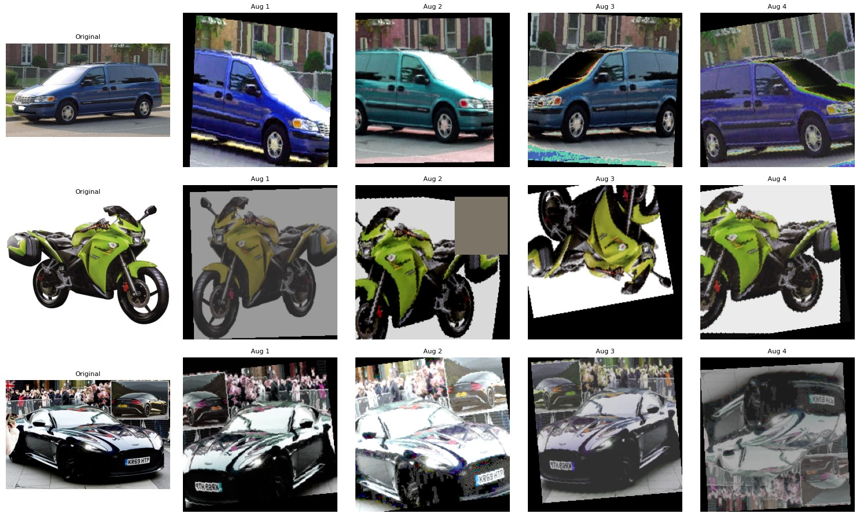
Dataset Augmentation

Slide 26
Optimizer Comparison
Why we chose AdamW?
V.s Adam:
Efficient Weight Decay
Separates weight decay from gradient updates
Better generalization & reduces overfitting
V.s SGD:
Adaptive Learning Rates
Notes:
Adam combines L2 regularisation with gradient updates, leading to suboptimal performance.
AdamW decouples weight decay from gradient updates, ensuring better generalisation and reduced overfitting.
SGD uses a fixed learning rate for all parameters, making convergence slow. AdamW adapts learning rates for each parameter based on their gradients' magnitude and history, enabling faster convergence.

Slide 27
Scheduler Comparison
Why CosineAnnealingWarmRestarts?
Vs. StepLR:
Smooth cyclic learning rates & preventing stagnation
Avoid getting stuck in local minima
Vs. Cyclical Learning Rates (CLR):
Decay slowly
Vs. ReduceLROnPlateau:
Aggressive Adjustments
Notes:
Vs. StepLR:
As StepLR reduces the learning rate by fixed steps, which sometimes is too fast and lead to suboptimal performance. CosineAnnealingWarmRestarts provides smoother, cyclic adjustments, leading to better training dynamics.
Also, The periodic restarts of the cosine annealing scheduler enable the model to explore new solutions, as it can prevent the model get stuck in local minima.
Vs. Cyclical Learning Rates (CLR):
CLR often oscillates indefinitely, which can affect the convergence, while cosine annealing gradually reduces learning rates overall for better stability.
Vs. ReduceLROnPlateau:
As CosineAnnealingWarmRestarts proactively schedules adjustments, ensuring smoother and more predictable training progress. ReduceLROnPlateau waits for performance metrics to stagnate, reacting late.

Slide 28


Slide 29
Test Accuracy!
98.75%

Slide 30
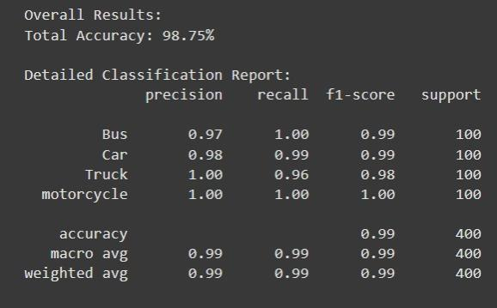
Results

Slide 31
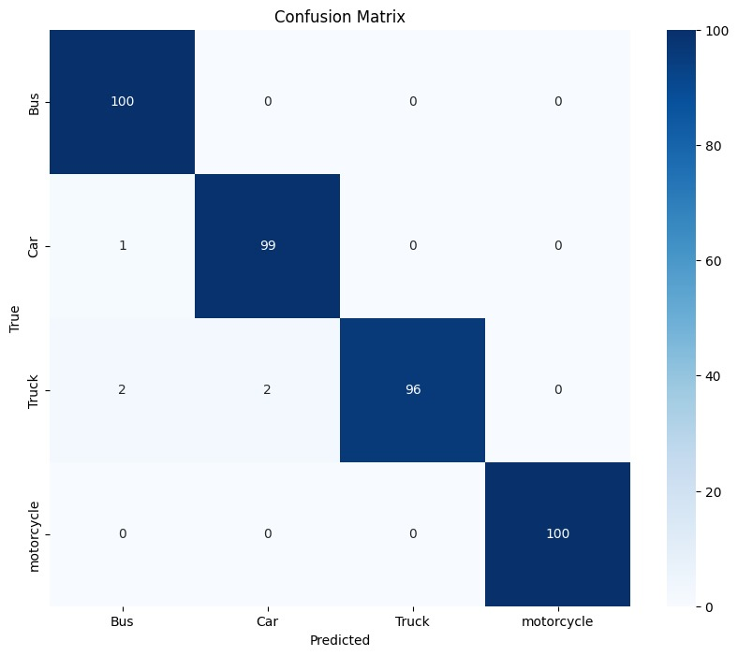
Non-Deep learning
Deep learning

Slide 32
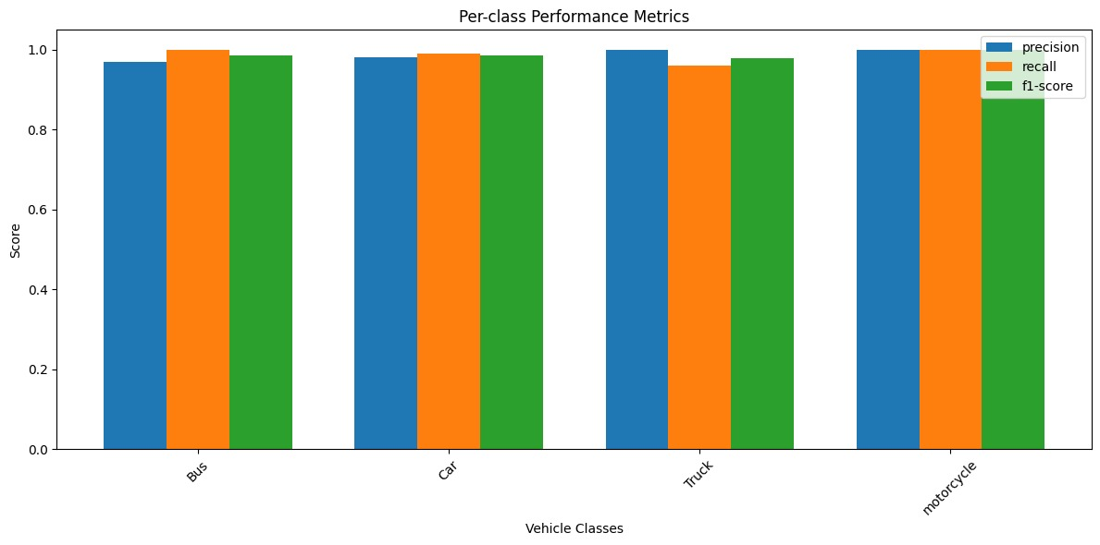

Slide 33
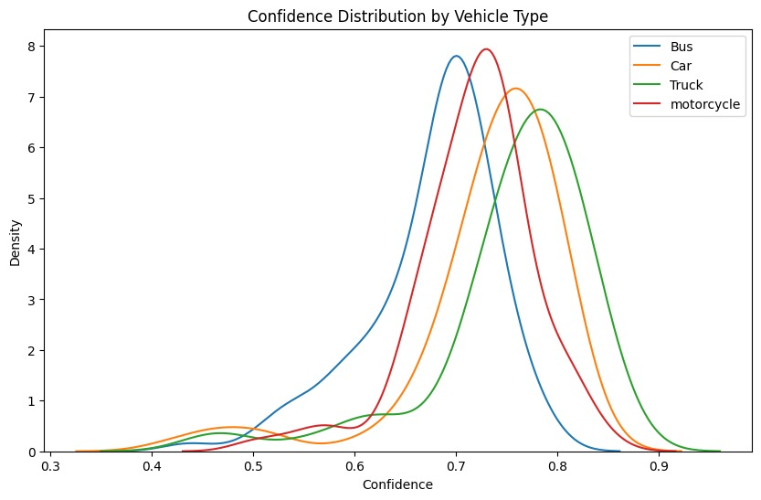

Slide 34
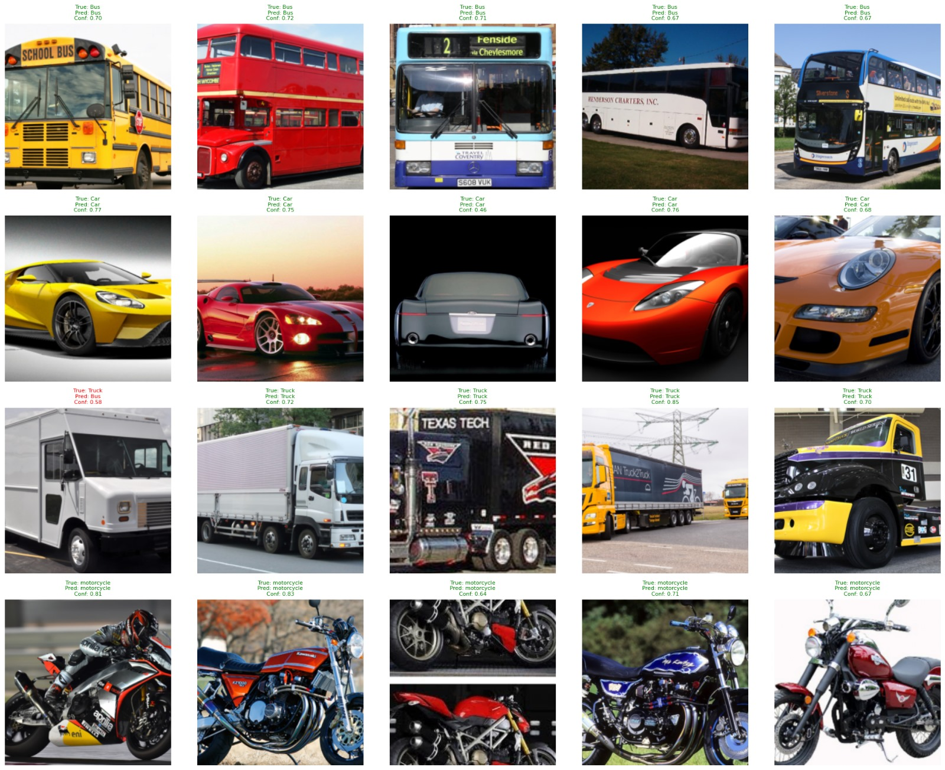

Slide 35
Comparison: SVM vs EfficientNet
Aspect | CNNs (Convolutional Neural Networks) | SVMs (Support Vector Machines)
Automatic Feature Learning | Learns hierarchical features automatically for the task | Relies on static, handcrafted features (e.g., HOG)
Model Capacity | Deep models with millions of parameters, capable of modeling complex, non-linear patterns | Shallow models with limited capacity
Handling Image Data | Designed specifically for image data, capturing spatial patterns | Loses spatial information when working on flattened feature vectors
Scalability | Scales well with large datasets, leverages GPU acceleration | Struggles with large datasets, especially with non-linear kernels
Regularization | Uses advanced techniques and data augmentation for better generalization | Has more limited regularization options
Transfer Learning | Can leverage pretrained models to enhance performance | Does not support transfer learning
Notes:
Automatic Feature Learning: CNNs automatically learn hierarchical features that are tailored to the task, while SVMs rely on static, handcrafted features (HOG in this case).
Model Capacity: CNNs are deep models with millions of parameters and can model complex, non-linear patterns, whereas SVMs are shallow models with limited capacity.
Handling Image Data: CNNs are specifically designed for image data and can capture spatial patterns, while SVMs lose spatial information when operating on flattened feature vectors.
Scalability: CNNs scale well with large datasets and can leverage GPU acceleration, while SVMs struggle with large datasets and non-linear kernels.
Regularization: CNNs use advanced regularization techniques and data augmentation to improve generalization, while SVMs have more limited regularization options.
Transfer Learning: CNNs can leverage pretrained models to boost performance, which is not an option for SVMs.

Slide 36
Thank You ☺

